Slide 1

MLAI 504
Neural networks and deep learning
  MIAI – 2026/2027
Dr. Zein Al Abidin IBRAHIM
zein.ibrahim@ul.edu.lb

Slide 2
neural networks:
A Quick overview
DEEP LEARNING

Slide 3
Perceptron
NEURAL NETWORK

Slide 4
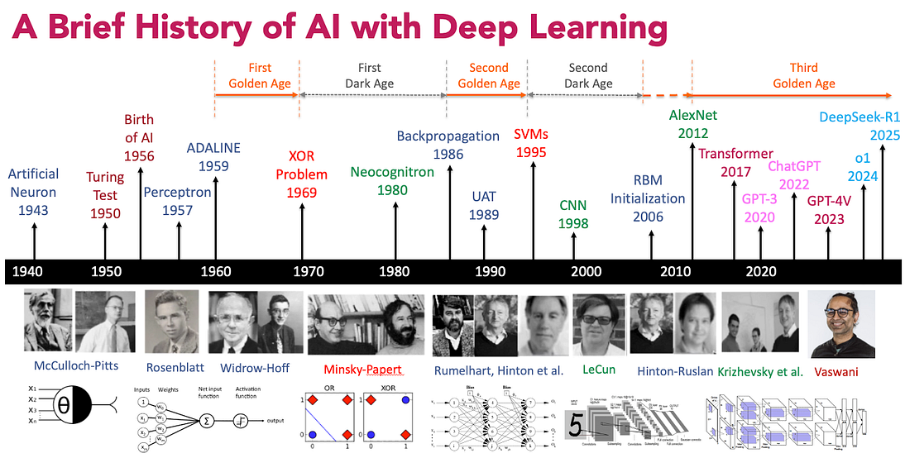
History
Notes:
https://maelfabien.github.io/deeplearning/Perceptron/#why-neurons

Slide 5
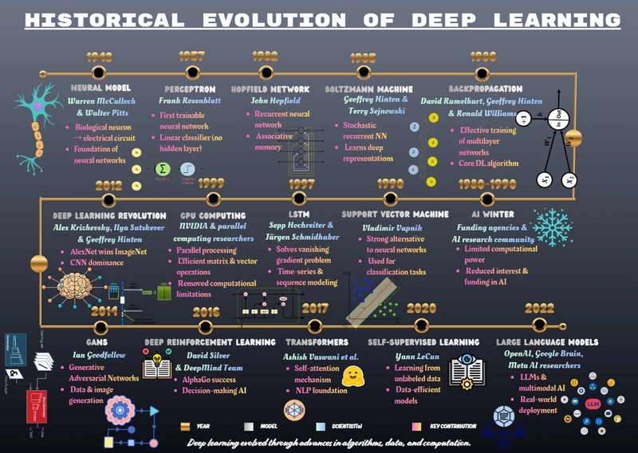
History
Notes:
https://maelfabien.github.io/deeplearning/Perceptron/#why-neurons

Slide 6
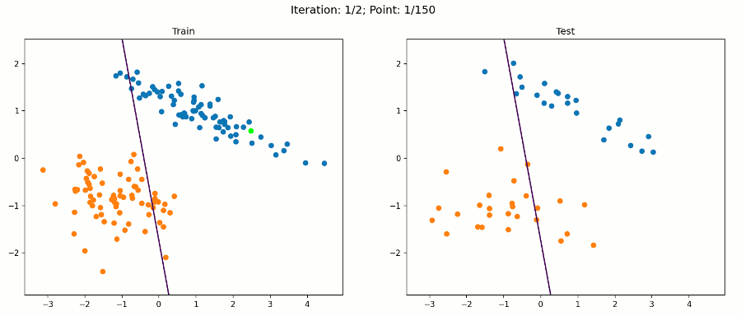
The Perceptron Conversion Theorem
For the perceptron to function properly, the two classes must be linearly separable.
  If the classes are allowed to be close as shown in Figure below (b) then it becomes beyond the capability of perceptron.

Slide 7
McCulloch-Pitts Vs Rosenblatt perceptron
Feature | McCulloch-Pitts Model | Rosenblatt Perceptron
Year | 1943 | 1958
Purpose | Theoretical model of biological neurons | Practical implementation of a single artificial neuron
Inputs | Binary (0 or 1) | Real-valued
Weights | All identical | Can be different and positive or negative
Threshold | Single, fixed | Single, adjustable during learning
Activation function | Step function | Step function
Learning rule | None | Perceptron learning rule
Applications | Theoretical foundation for artificial neural networks | Simple pattern recognition, linear binary classification
Strengths | Laid the groundwork for artificial neurons, provided a simple model to understand | Introduced the concept of learning in neural networks, enabled practical applications
Weaknesses | Limited to binary inputs and outputs, couldn't solve non-linearly separable problems, no learning mechanism | Limited to linearly separable problems, slow convergence in some cases
Notes:
The McCulloch-Pitts model and the Rosenblatt perceptron are both early models of artificial neurons, but they have some key differences:
Origin:
The McCulloch-Pitts model was introduced by Warren McCulloch and Walter Pitts in 1943. It was a mathematical model inspired by the biological understanding of how neurons work in the brain.
The Rosenblatt perceptron was proposed by Frank Rosenblatt in 1957. It was designed as a simplified computational model of a biological neuron and aimed at performing binary classification tasks.
Functionality:
The McCulloch-Pitts model is a binary threshold model. It takes binary inputs and produces a binary output based on a threshold function. It does not learn from data; instead, it is more of a theoretical model for understanding computation in neural networks.
The Rosenblatt perceptron extends the McCulloch-Pitts model by introducing the concept of weights. It is capable of learning from data through a training process. The perceptron uses a linear combination of inputs, and a threshold function to produce a binary output.
Learning:
The McCulloch-Pitts model does not include a learning algorithm. It is a fixed model that operates based on its specified connections and thresholds.
The Rosenblatt perceptron incorporates a simple learning rule, known as the perceptron learning rule. This rule allows the perceptron to adjust its weights based on errors in classification during training.
Representation of Neurons:
In the McCulloch-Pitts model, neurons are represented as binary on-off switches. They do not have continuous-valued activations or weights.
In the Rosenblatt perceptron, neurons are represented with real-valued weights and activations. The continuous nature of weights and activations allows for a more flexible and adaptive behavior.
Architecture:
The McCulloch-Pitts model is more of a theoretical construct and doesn't specify a layered network architecture. It focuses on the logical operations performed by individual neurons.
The Rosenblatt perceptron is designed to be part of a layered network architecture. Multiple perceptrons can be connected to form a network capable of more complex tasks.

Slide 8
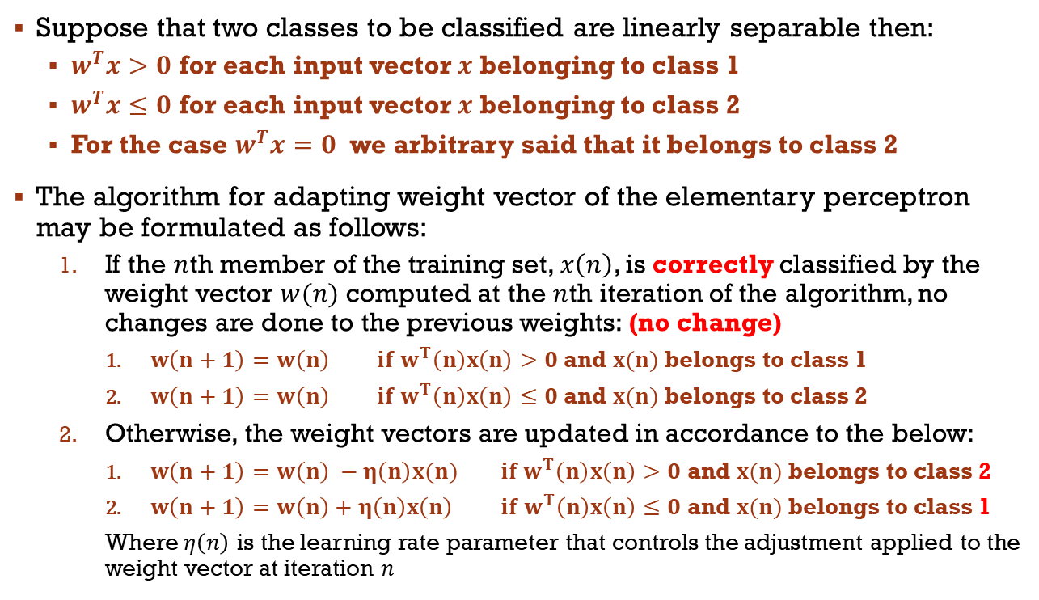
The Perceptron Conversion Theorem
Suppose that two classes to be classified are linearly separable then:
  $w^{T}x>0$ for each input vector $x$ belonging to class 1
  $w^{T}x≤0$ for each input vector $x$ belonging to class 2
  For the case $w^{T}x=0$ we arbitrary said that it belongs to class 2
The algorithm for adapting weight vector of the elementary perceptron may be formulated as follows:
  If the $n$th member of the training set, $x\left(n\right)$, is correctly classified by the weight vector $w(n)$ computed at the $n$th iteration of the algorithm, no changes are done to the previous weights: (no change)
    $w\left(n+1\right)=w\left(n\right) if w^{T}\left(n\right)x\left(n\right)>0$ and $x(n)$ belongs to class 1
    $w\left(n+1\right)=w\left(n\right) if w^{T}\left(n\right)x\left(n\right)≤0$ and $x(n)$ belongs to class 2
  Otherwise, the weight vectors are updated in accordance to the below:
    $w\left(n+1\right)=w\left(n\right) −η\left(n\right)x(n) if w^{T}\left(n\right)x\left(n\right)>0$ and $x(n)$ belongs to class 2
    $w\left(n+1\right)=w\left(n\right)+η\left(n\right)x\left(n\right) if w^{T}\left(n\right)x\left(n\right)≤0$ and $x(n)$ belongs to class 1
    Where $η\left(n\right)$ is the learning rate parameter that controls the adjustment applied to the weight vector at iteration $n$

Slide 9
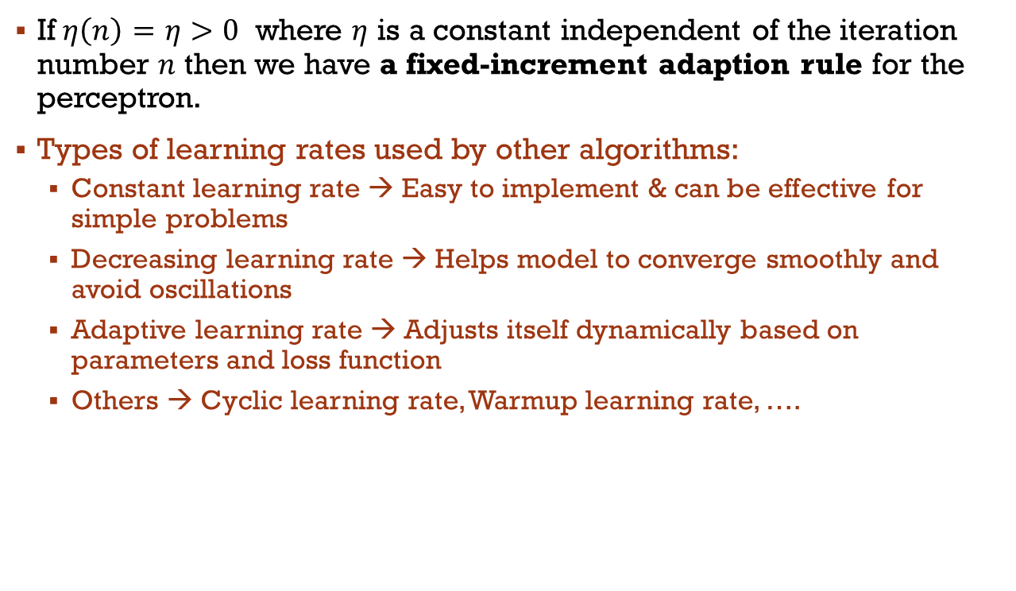
Learning rate
If$η\left(n\right)=η>0$ where $η$ is a constant independent of the iteration number $n$ then we have a fixed-increment adaption rule for the perceptron.
Types of learning rates used by other algorithms:
  Constant learning rate → Easy to implement & can be effective for simple problems
  Decreasing learning rate → Helps model to converge smoothly and avoid oscillations
  Adaptive learning rate → Adjusts itself dynamically based on parameters and loss function
  Others → Cyclic learning rate, Warmup learning rate, ….

Slide 11
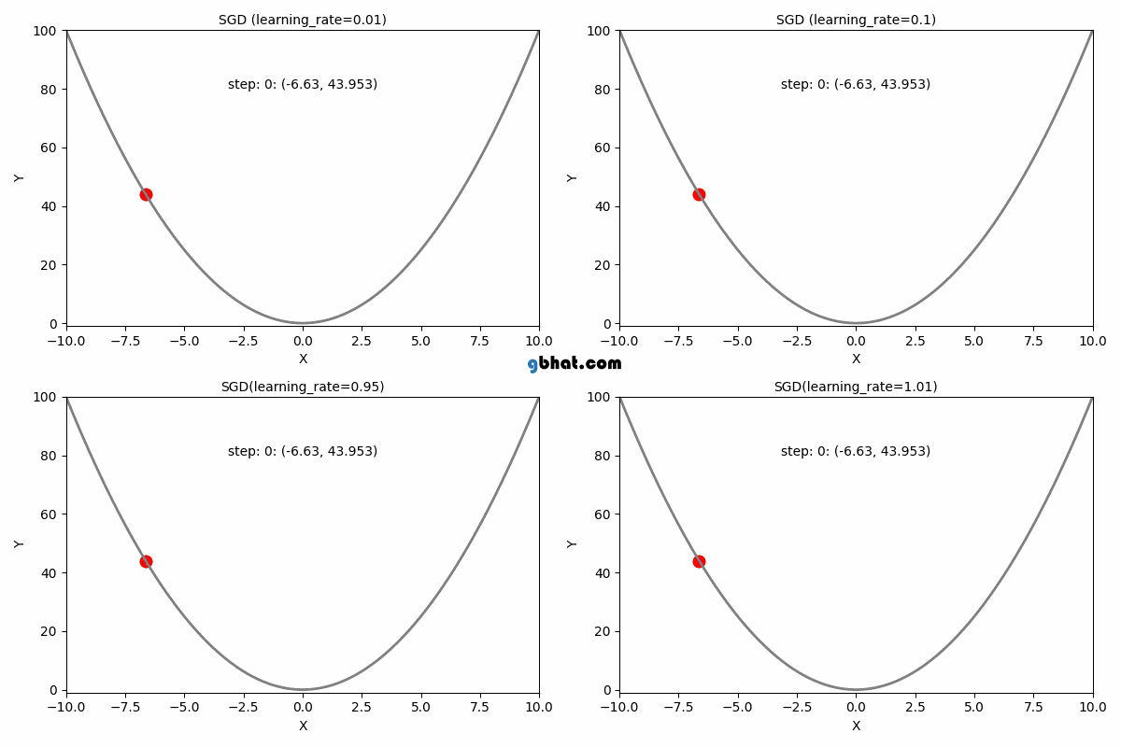
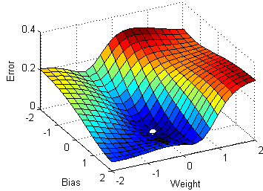
Gradient Descent Learning Rates

Slide 12
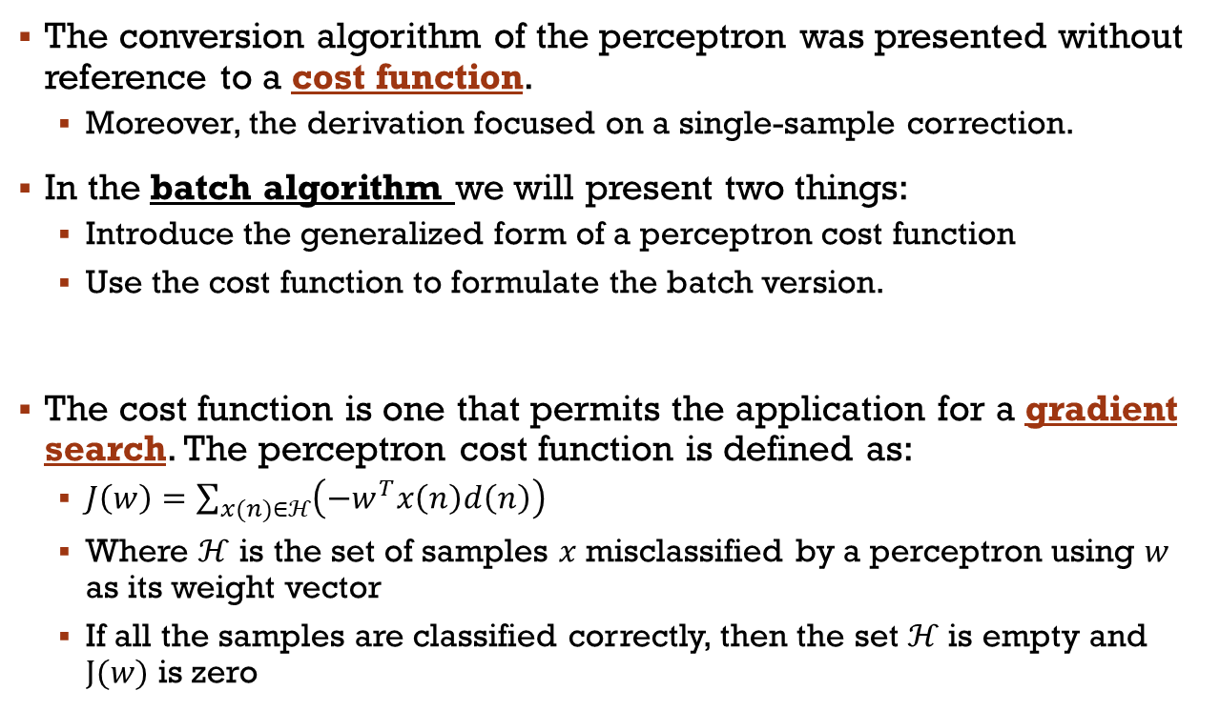
The Batch Perceptron Algorithm
The conversion algorithm of the perceptron was presented without reference to a cost function.
  Moreover, the derivation focused on a single-sample correction.
In the batch algorithm we will present two things:
  Introduce the generalized form of a perceptron cost function
  Use the cost function to formulate the batch version.
The cost function is one that permits the application for a gradient search. The perceptron cost function is defined as:
  $J\left(w\right)=\sum_{x(n)∈ℋ}{\left(−w^{T}x\left(n\right)d\left(n\right)\right)}$
  Where $ℋ$ is the set of samples $x$ misclassified by a perceptron using $w$ as its weight vector
  If all the samples are classified correctly, then the set $ℋ$ is empty and $J(w)$ is zero
Notes:
Batch-training → one update after processing a batch of samples.
Stochastic training → one update after processing one individual sample.
Mini-batch training → one update after processing a small subset of data

Slide 13
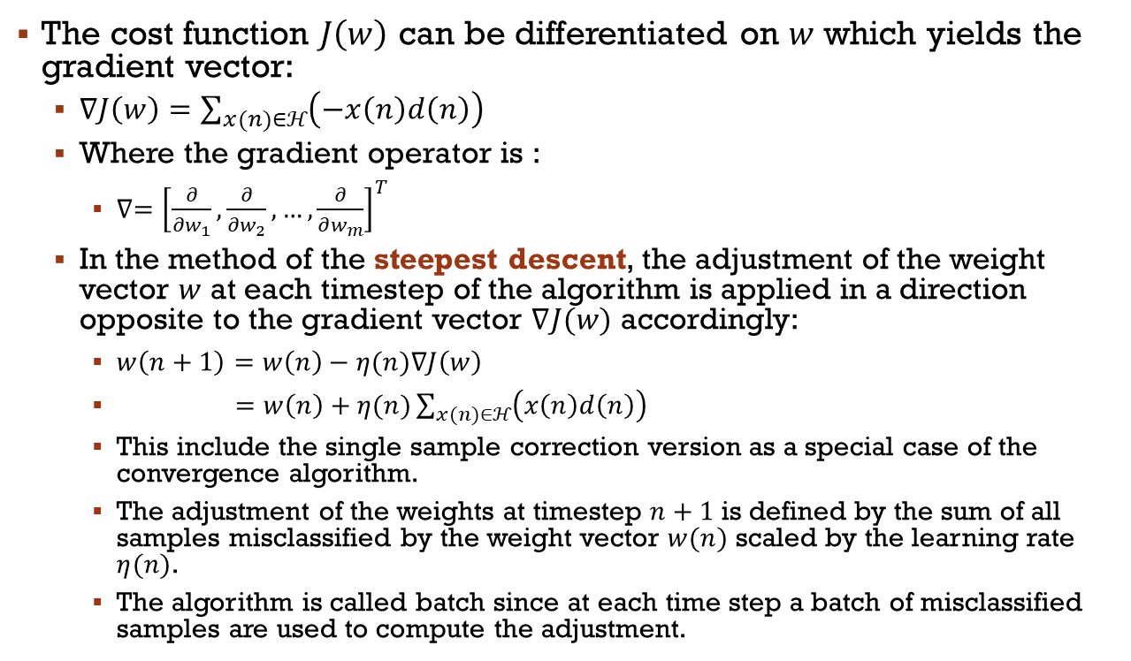
The Batch Perceptron Algorithm
The cost function $J\left(w\right)$ can be differentiated on $w$ which yields the gradient vector:
  $∇J\left(w\right)=$ $\sum_{x(n)∈ℋ}{\left(−x\left(n\right)d\left(n\right)\right)}$
  Where the gradient operator is :
    $∇={\left[\frac{∂}{∂w_{1}},\frac{∂}{∂w_{2}},…,\frac{∂}{∂w_{m}}\right]}^{T}$
  In the method of the steepest descent, the adjustment of the weight vector $w$ at each timestep of the algorithm is applied in a direction opposite to the gradient vector $∇J(w)$ accordingly:
    $w\left(n+1\right)=w\left(n\right)−η(n)∇J\left(w\right)$
    $=w\left(n\right)+η(n)\sum_{x(n)∈ℋ}{\left(x\left(n\right)d\left(n\right)\right)}$
    This include the single sample correction version as a special case of the convergence algorithm.
    The adjustment of the weights at timestep $n+1$ is defined by the sum of all samples misclassified by the weight vector $w(n)$ scaled by the learning rate $η(n)$.
    The algorithm is called batch since at each time step a batch of misclassified samples are used to compute the adjustment.

Slide 14
Gradient Descent
Fundamental algorithm in machine learning and optimization.
Used to train various models.
How it works:
  Imagine you're lost in a mountainous landscape and trying to find the valley (minimum point).
  Gradient descent would be like taking small steps downhill, always following the steepest slope you can feel.
Here's the gist:
  Imagine a function as a landscape: The function's output (like error) varies depending on its inputs. High points represent areas with high error (think of them as hills).
  Start at a random point: This is your initial guess for the model's parameters (weights).
  Calculate the slope (gradient): This tells you how much and in which direction the error changes when you move a little bit.
  Take a small step downhill: Adjust the parameters slightly in the direction of the steepest descent.
  Repeat: Keep calculating the slope and taking small steps downhill, until you reach a point where the slope is almost zero (a minimum).

Slide 15
Gradient Descent – A pre-look
Different types of gradient descent:
  Batch gradient descent: Considers the entire dataset for each step, can be slow for large datasets.
  Stochastic gradient descent: Considers only one data point at a time, faster but can be noisy.
  Mini-batch gradient descent: Considers a small batch of data points at a time, balances speed and stability.
Gradient descent is powerful, but it's not perfect:
  Can get stuck in local minima: Imagine being stuck in a small valley instead of the main one. You'd need a good starting point or momentum to escape.
  Requires differentiable functions: Not all functions are smooth enough for gradient descent to work.
  Can be sensitive to learning rate: A too-high rate might overshoot the minimum, too-low might get stuck.

Slide 16
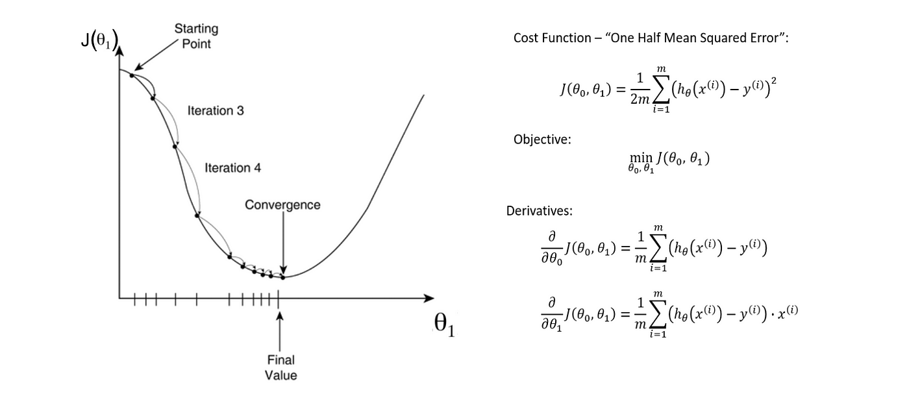
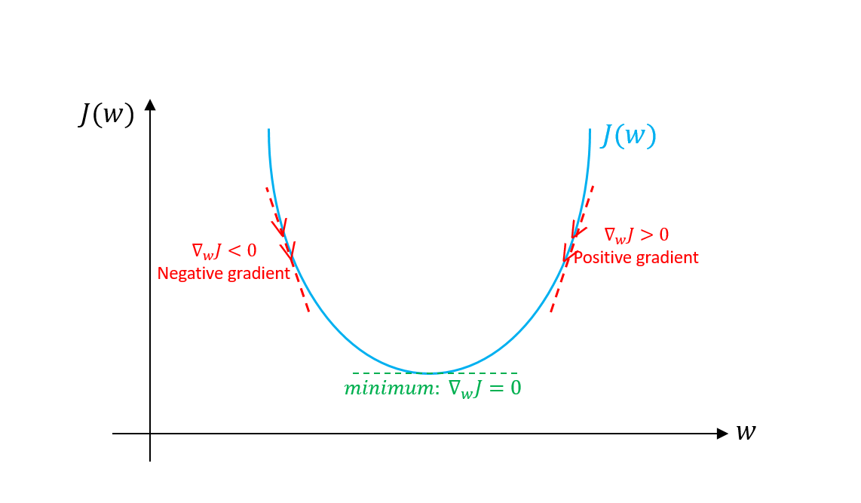
Gradient Descent

Slide 17
Perceptron Vs Gradient Descent
Similarity:
Both are iterative optimization algorithms used to minimize an error function.
Both update the parameters (weights) of a model based on the gradient of the error function.
Both work well for linear problems or can be used with non-linear problems if combined with other techniques like feature engineering or neural networks.
Feature | Gradient Descent | Perceptron
Objective function | Any differentiable function | Misclassification error (for binary classification)
Learning rule | Adjusts weights proportionally to the gradient | Updates weights only if prediction is wrong
Convergence guarantee | No guaranteed convergence (can get stuck in local minima) | Guaranteed convergence for linearly separable problems
Number of updates per iteration | Updates all weights at once | Updates only weights of misclassified inputs
Applications | Wider range of tasks, including regression, multi-class classification, etc. | Simple binary classification problems

Slide 18
Problem Solving
Perceptron

Slide 19
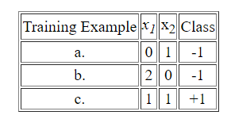
Data Analysis
Given the below dataset
Construct by hand a Perceptron which correctly classifies the above data. Use your knowledge of plane geometry to choose appropriate values for the weights w₀, w₁ and w₂.
Demonstrate the Perceptron Learning Algorithm on the above data, using a learning rate of 1.0 and initial weight values of
w₀ = -1.5, w₁ = 0, w₂ = 2
In your answer, you should clearly indicate the new weight values at the end of each training step.

Slide 20
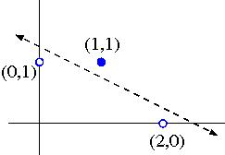
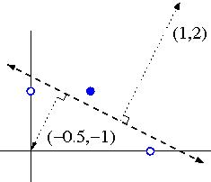
Data Analysis
Solution (part a)
First → plot the data in the 2D space (figure bottom left)
This line has slope -1/2 and x₂-intersect 5/4, so its equation is:
x₂ = 5/4 - x₁/2, i.e. 2x₁ + 4x₂ - 5 = 0.
Taking account of which side is positive, this corresponds to these weights:
w₀ = -5, w₁ = 2, w₂ = 4
Alternatively, we can derive weights w₁=1 and w₂=2 by drawing a vector normal to the separating line, in the direction pointing towards the positive data points:
The bias weight w₀ can then be found by computing the dot product of the normal vector with a perpendicular vector from the separating line to the origin. In this case w₀ = 1(-0.5) + 2(-1) = -2.5
(Note: these weights differ from the previous ones by a normalizing constant, which is fine for a Perceptron)

Slide 21
Data Analysis
Solution (part b)
Iteration | w₀ | w₁ | w₂ | Training Example | x₁ | x₂ | Class | s=w₀+w₁x₁+w₂x₂ | Action
1 | -1.5 | 0 | 2 | a. | 0 | 1 | - | +0.5 | Subtract
2 | -2.5 | 0 | 1 | b. | 2 | 0 | - | -2.5 | None
3 | -2.5 | 0 | 1 | c. | 1 | 1 | + | -1.5 | Add
4 | -1.5 | 1 | 2 | a. | 0 | 1 | - | +0.5 | Subtract
5 | -2.5 | 1 | 1 | b. | 2 | 0 | - | -0.5 | None
6 | -2.5 | 1 | 1 | c. | 1 | 1 | + | -0.5 | Add
7 | -1.5 | 2 | 2 | a. | 0 | 1 | - | +0.5 | Subtract
8 | -2.5 | 2 | 1 | b. | 2 | 0 | - | +1.5 | Subtract
9 | -3.5 | 0 | 1 | c. | 1 | 1 | + | -2.5 | Add
10 | -2.5 | 1 | 2 | a. | 0 | 1 | - | -0.5 | None
11 | -2.5 | 1 | 2 | b. | 2 | 0 | - | -0.5 | None
12 | -2.5 | 1 | 2 | c. | 1 | 1 | + | +0.5 | None

Slide 22
Problem solving session
Consider a McCulloch-Pitts Neural Network. Design one that implements a 1 input NOT Gate
Input 1 | Output
0 | 1
1 | 0
Notes:
[0.5,-1] =[w0,w1,w2]
The McCulloch-Pitts (MP) model, as originally formulated, did not explicitly contain a bias term in the way modern neural networks do.
Instead of a separate bias, the MP model incorporates its bias function implicitly through the fixed threshold (θ) of the neuron.

Slide 23
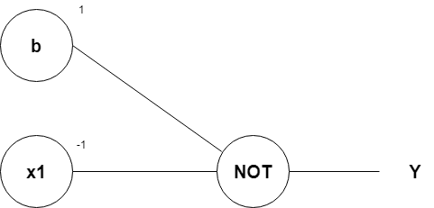
Problem solving session
Consider a McCulloch-Pitts Neural Network. Design one that implements a 1 input NOT Gate
Input 1 | Output
0 | 1
1 | 0
Notes:
[-1,1,1] =[w0,w1,w2]

Slide 24
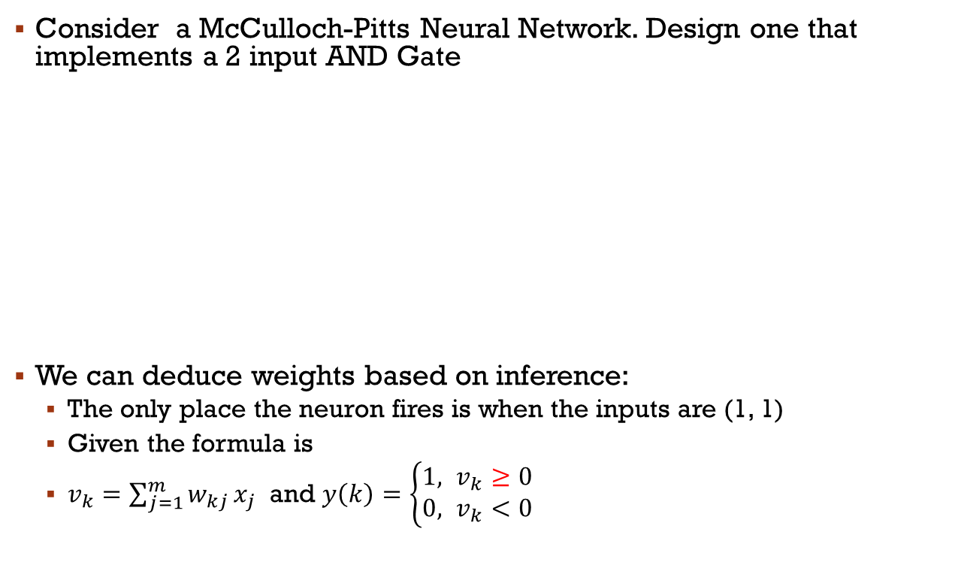
Problem solving session
Consider a McCulloch-Pitts Neural Network. Design one that implements a 2 input AND Gate
We can deduce weights based on inference:
  The only place the neuron fires is when the inputs are (1, 1)
  Given the formula is
  $v_{k}=\sum_{j=1}^{m}{w_{kj}}x_{j}$ and $y\left(k\right)=\left\{\begin{aligned}1, v_{k}≥0 \\ &0, v_{k}<0\end{aligned}\right.$
Input 1 | Input 2 | Output
0 | 0 | 0
0 | 1 | 0
1 | 0 | 0
1 | 1 | 1
Input 1
Output
Input 2
Notes:
[-1,1,1] =[w0,w1,w2]

Slide 25
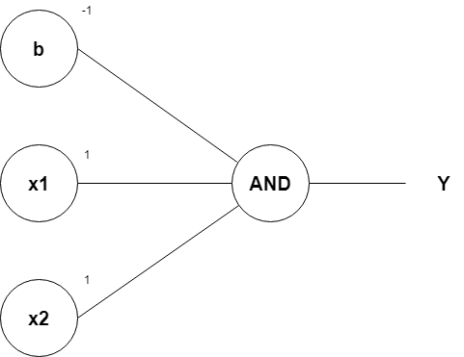
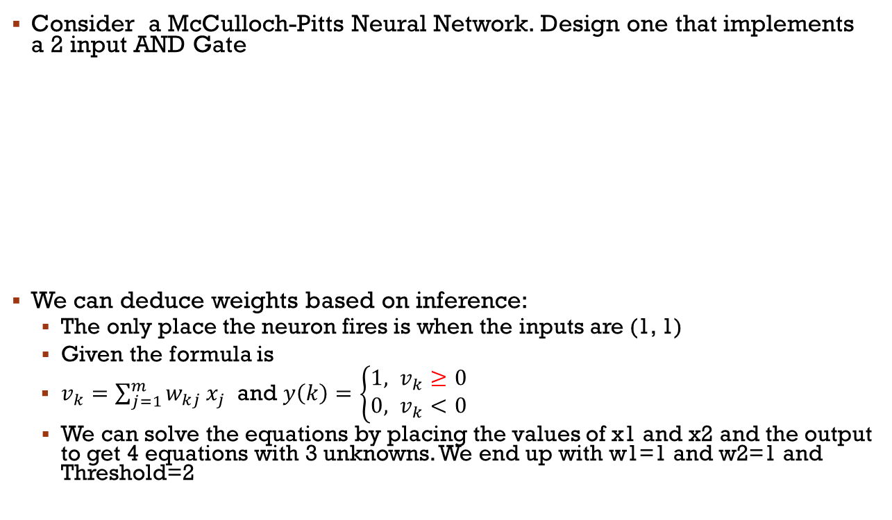
Problem solving session
Consider a McCulloch-Pitts Neural Network. Design one that implements a 2 input AND Gate
We can deduce weights based on inference:
  The only place the neuron fires is when the inputs are (1, 1)
  Given the formula is
  $v_{k}=\sum_{j=1}^{m}{w_{kj}}x_{j}$ and $y\left(k\right)=\left\{\begin{aligned}1, v_{k}≥0 \\ &0, v_{k}<0\end{aligned}\right.$
  We can solve the equations by placing the values of x1 and x2 and the output to get 4 equations with 3 unknowns. We end up with w1=1 and w2=1 and Threshold=2
Input 1 | Input 2 | Output
0 | 0 | 0
0 | 1 | 0
1 | 0 | 0
1 | 1 | 1

Slide 26

Problem solving session
Consider a McCulloh Pitts Neural Network. Design one that implements a 2 input AND Not Gate
We can deduce weights based on inference:
  The only place the neuron fires is when the inputs are (1, 0)
  Given the formula is
  $v_{k}=\sum_{j=1}^{m}{w_{kj}}x_{j}$ and $y\left(k\right)=\left\{\begin{aligned}1, v_{k}≥0 \\ &0, v_{k}<0\end{aligned}\right.$
Input 1 | Input 2 | Output
0 | 0 | 0
0 | 1 | 0
1 | 0 | 1
1 | 1 | 0
Input 1
Output
Input 2

Slide 27
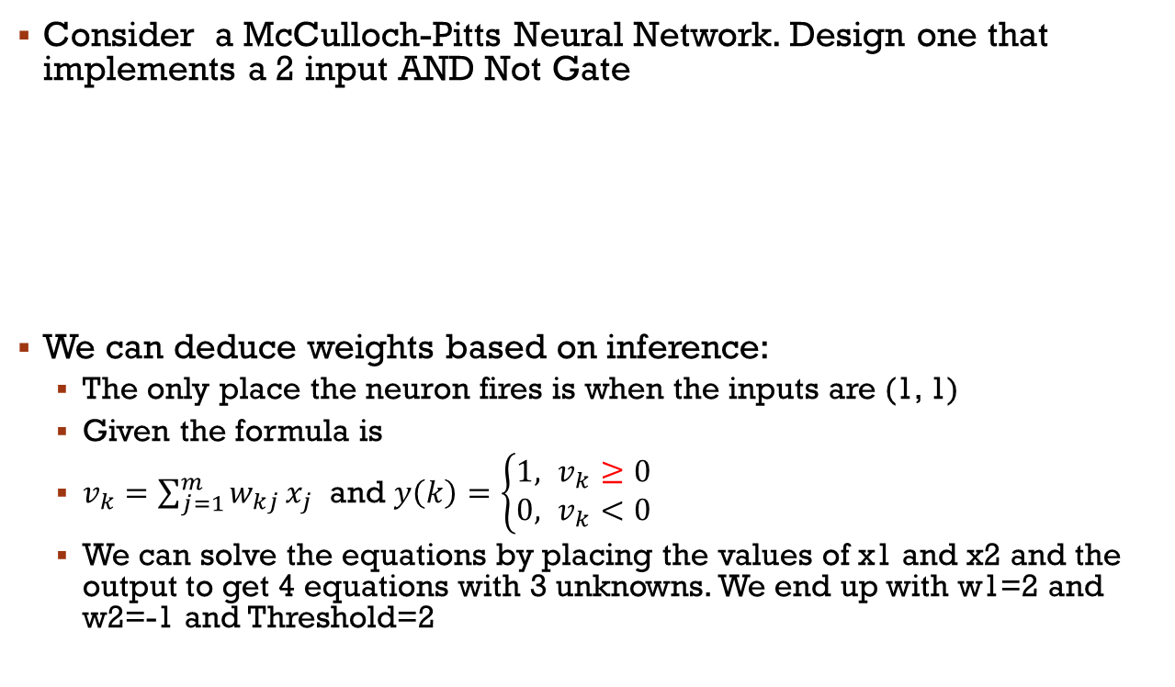
Problem solving session
Consider a McCulloch-Pitts Neural Network. Design one that implements a 2 input AND Not Gate
We can deduce weights based on inference:
  The only place the neuron fires is when the inputs are (1, 1)
  Given the formula is
  $v_{k}=\sum_{j=1}^{m}{w_{kj}}x_{j}$ and $y\left(k\right)=\left\{\begin{aligned}1, v_{k}≥0 \\ &0, v_{k}<0\end{aligned}\right.$
  We can solve the equations by placing the values of x1 and x2 and the output to get 4 equations with 3 unknowns. We end up with w1=2 and w2=-1 and Threshold=2
Input 1 | Input 2 | Output
0 | 0 | 0
0 | 1 | 0
1 | 0 | 1
1 | 1 | 0

Slide 28
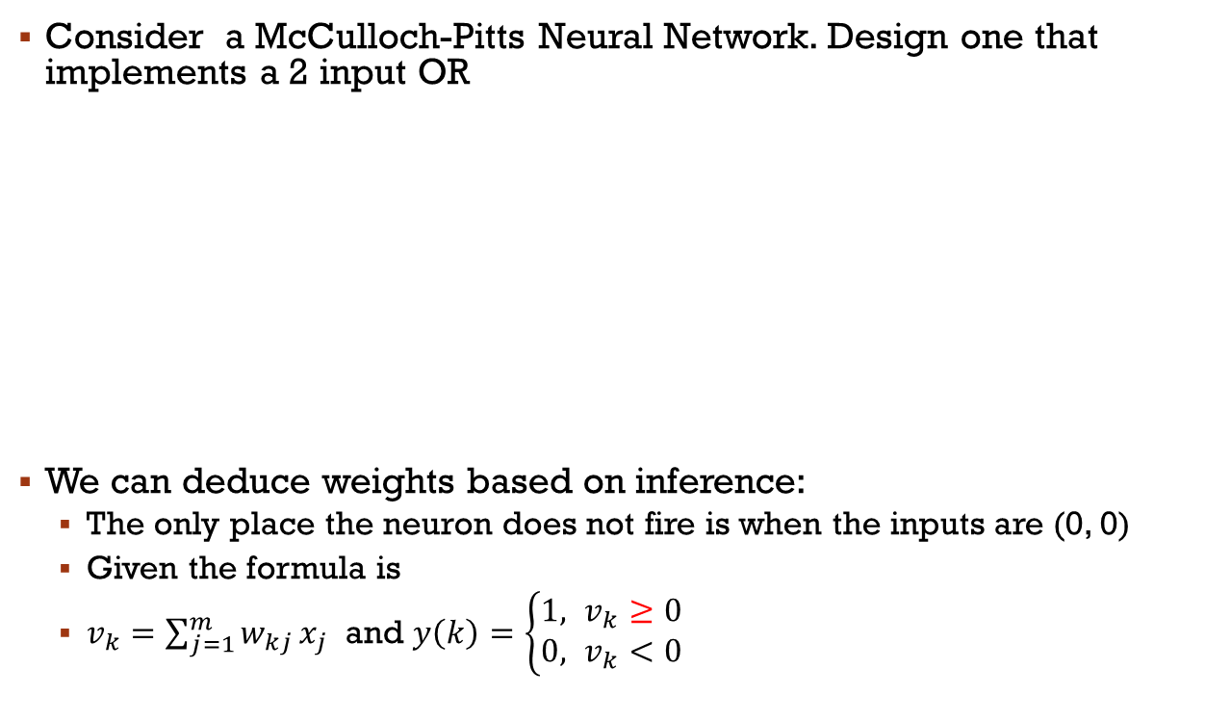
Problem solving session
Consider a McCulloch-Pitts Neural Network. Design one that implements a 2 input OR
We can deduce weights based on inference:
  The only place the neuron does not fire is when the inputs are (0, 0)
  Given the formula is
  $v_{k}=\sum_{j=1}^{m}{w_{kj}}x_{j}$ and $y\left(k\right)=\left\{\begin{aligned}1, v_{k}≥0 \\ &0, v_{k}<0\end{aligned}\right.$
Input 1 | Input 2 | Output
0 | 0 | 0
0 | 1 | 1
1 | 0 | 1
1 | 1 | 1
Input 1
Output
Input 2
Notes:
[-1,2,2]

Slide 29

Problem solving session
Consider a McCulloch-Pitts Neural Network. Design one that implements a 2 input OR
We can deduce weights based on inference:
  The only place the neuron does not fire is when the inputs are (0, 0)
  Given the formula is
  $v_{k}=\sum_{j=1}^{m}{w_{kj}}x_{j}$ and $y\left(k\right)=\left\{\begin{aligned}1, v_{k}≥0 \\ &0, v_{k}<0\end{aligned}\right.$
Input 1 | Input 2 | Output
0 | 0 | 0
0 | 1 | 1
1 | 0 | 1
1 | 1 | 1
Notes:
Started by [-1,1,1]

Slide 30
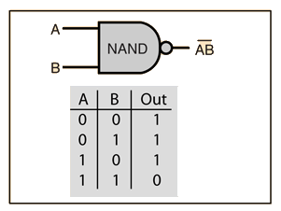
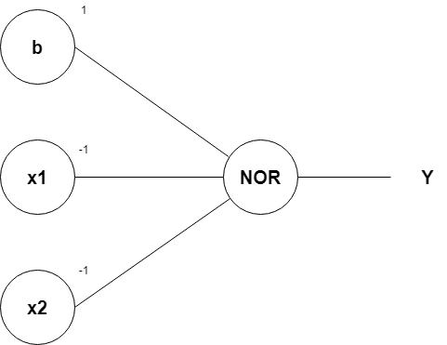
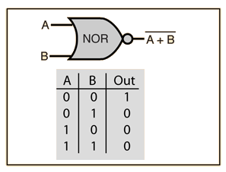

Problem solving session
Think to other gates like
Notes:
[-1,2,2]

Slide 31
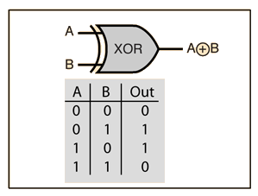
Problem solving session
What about the following
Notes:
Cannot be solved with single neuron

